Slide 1
DEEP NEURAL NETWORK MODEL
With Lth Layer
Presenting By: Presenting To:
Abhishek Kumar Dr. Yamuna P. Shukla
2019PCS0002 Ms. Ambreen Bahsir

Slide 2
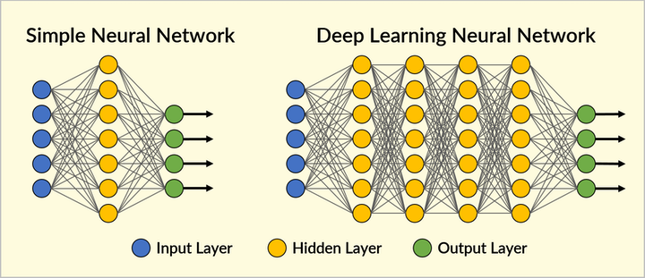
Deep Neural Network

Slide 3
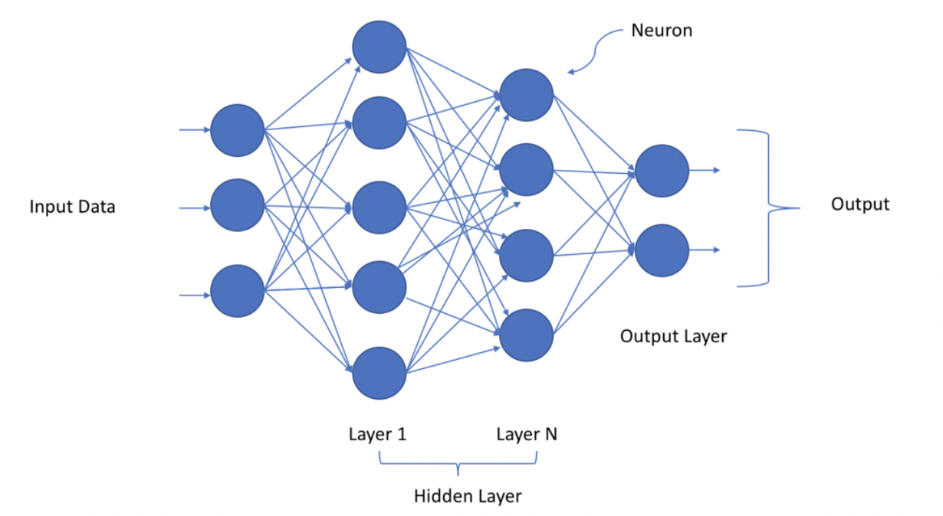

Slide 4
Alogrithmic Approach
Initialization weights and biases for L-layer
Forword Propagation:
i) Linear Forword
II) Linear Activation Forword
Computing Cost Function
Backword Propagation
i) Linear Backword
ii) Linear Activation Backword
Update Parameter
Prediction

Slide 5
Initialization
Z[l]=W[l]A[l−1]+b[l]
Random initialization for the weight matrices.
Zero initialization for the biases.

Slide 6
Forword Propagation
LINEAR
LINEAR->ACTIVATION where ACTIVATION can be Any Activation Function
[LINEAR -> RELU] × (L-1) -> LINEAR -> SIGMOID { Model Structure}
Z[l]=W[l]A[l-1]+b[l]
Where, A[0]=X;
X: Set of Input Vectors
W[l]: Weight matrix of lth layer
b[l]: Biases of lth layer
A[l]=g(Z[l]);
[l]
=
W
[l]
A
[l−1]
+
b

Slide 7
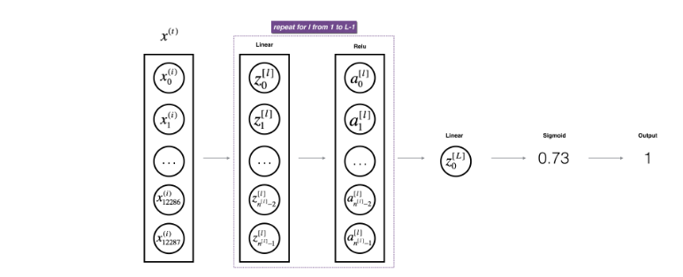

Slide 8
Cost Function
Cross-entropy cost:

Slide 9
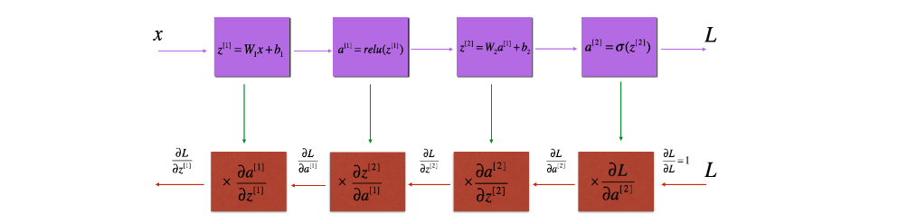
Backword Propagation

Slide 10
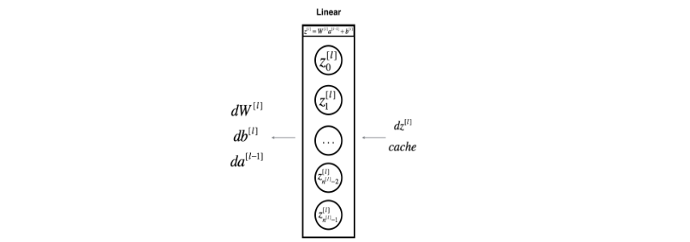
Linear Backword

Slide 11


Slide 12
Linear-Activation backward
dZ[l]= dA[l]*g’(Z[l])

Slide 13
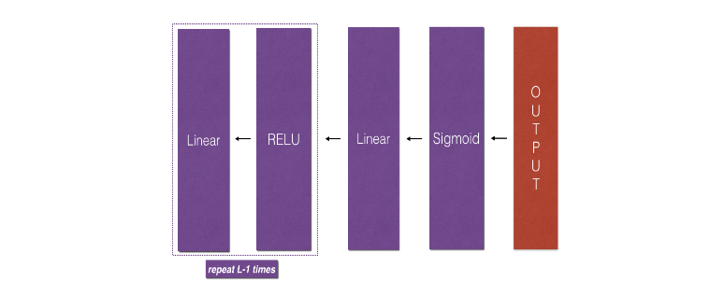
L-model Backword

Slide 14
Updating Parameter
W[l]=W[l]-α * dW[l];
b[l]=b[l]-α * db[l];

Slide 15
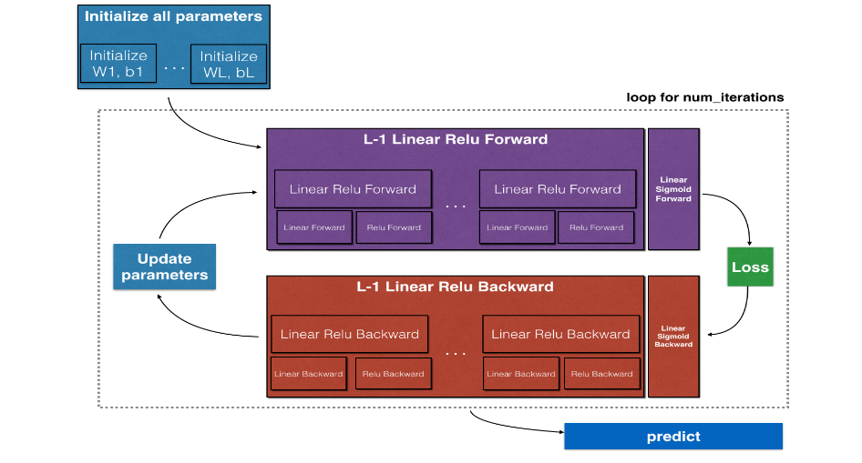
Conclusion

Slide 16
Thank You

